Slide 1




Computer Science CS033a
Multimedia and Communication
Lecture #5
The Internet and World Wide Web

Slide 2
Today’s Lecture
The Internet and World Wide Web
What You need to know when working in the world of website development
What is the Internet
How does it work
What is TCP/IP
What is an IP Address
What is a Domain Name
Rules for Domain Names
Picking a Domain Name
Picking an ISP
Next Lecture:
  Design Criteria
  Bad Designs
  Effective Designs
  Dreamweaver – basic principles

Slide 3
Web Development
What You need to know when working in the world of website development
Choose a Domain Name
http://www.youtube.com/watch?v=7WpmdaUGWL0
Order Web Hosting
Meet with Client
Create the Web Site
But First! You need to know
Internet Fundamentals !

Slide 4
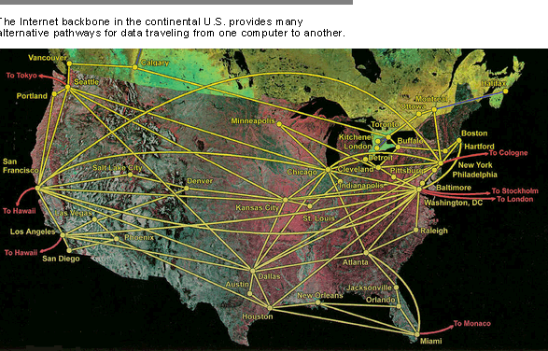
Internet Fundamentals
How does data travel?

Slide 5
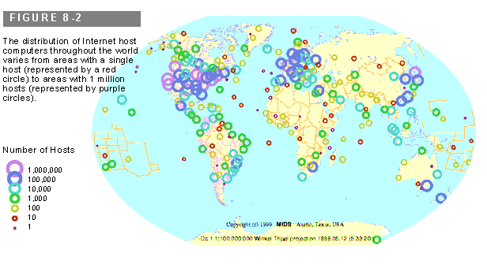
Computer Network
Internet Fundamentals
Group of millions of computers around the world that are connected to one another
Network: a group of interconnected computers
(could be connected with wires, wirelessly, satellites)
Network Configurations
Distribution of Internet Hosts throughout the World:
Single Host – red circle
Areas of 1 million hosts

Slide 6
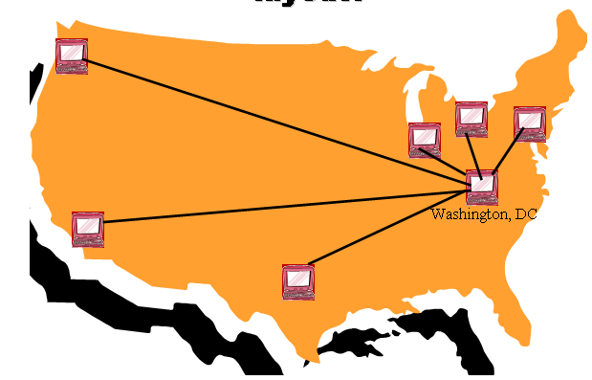
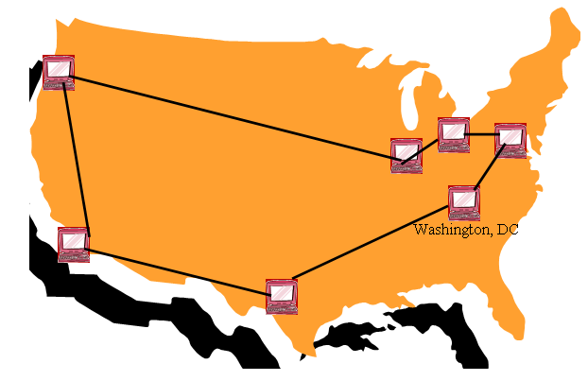
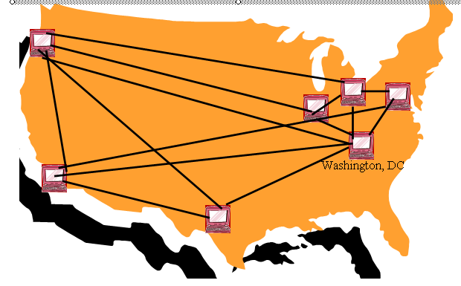
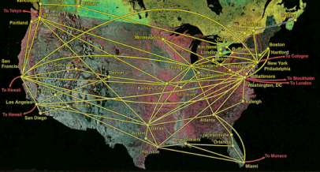
Network Configurations
Network: a group of interconnected computers
(could be connected with wires, wirelessly, satellites)
Network Configurations – The Pros and Cons

Slide 7
The Internet
What is the Internet?
a global system of interconnected computer networks that use the standardized Internet Protocol Suite (TCP/IP) to serve billions of users worldwide.
A network of networks
The Internet is hardware -
The World Wide Web is software that runs on the Internet!
Uses TCP/IP
A standard protocol
Transmission Control Protocol
Rules for the format and transmission of data
The ideas behind this protocol were funded by the Advanced Research Projects Agency (ARPA) of the US Department of Defence (DoD) (around 1969). Thus the Internet was originally call the ARPANET
How does one connect to the Internet?
Internet service provider (ISP) by modem
Internet ready cable
digital subscriber line (DSL)

Slide 8

How Does the Internet Work?
Imagine that I had a written a manuscript, printed it but I had NOT stapled it together. I have to get it from our classroom to my publisher in Toronto at Bloor and Yonge.
  Idea 1:
  Give the whole manuscript to one of you and tell you at the beginning to take the whole manuscript,
  drive down Western road south, till it meets the 401
  go east till you get to the cut off for Yonge street,
  go south and stop at Bloor.
  AND I WILL STOP ALL TRAFFIC ON THESE ROADS WHILE YOU DO THIS.
  This is how a phone line work!
  Called Circuit Switching

Slide 9
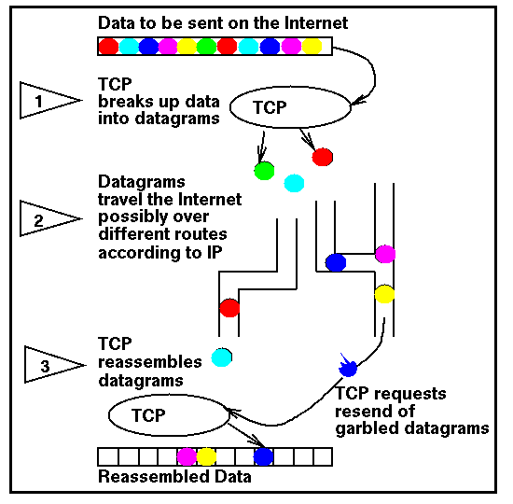
How Does the Internet Work?
  Idea 2:
Each page in the manuscript is similar to a packet. And they all take different paths to get to the destination
On the Internet, data is sent by
transferring packets where:
Packet: a small group of bytes consisting of:
    Header (64 bytes )
      Destination: tells where it is going: destination
      Source (where it came from)
    Body (512 bytes)
      Actual message content
← Manuscript ->
Each circle represents a packet (page)
  Called Packtet Switching

Slide 10
How does the Internet Work?
TCP (Transmission Control Protocol)
At the sending end:
  Take a large chunk of data (such as a webpage, email message, etc) and
  breaks it into small packets
  IP is responsible for sending the packets out on to the Internet
At the receiving end:
  Detects lost packets, error packets because of network congestion, traffic load balancing etc.. Thus, requests the packet to be resent from the source
  Rearranges and reassembles the packets back into the webpage, email message, etc on the receivers machine

Slide 12
How does the Internet Work?
IP (Internet Protocol)
IP is like a GPS
Picks a route for a pocket, stopping at routers (devices) which pick the next best machine/network to send the packet to (the router is the central switching device).
If a communication line is down or broken, the packet is given back to TCP who sends it again to try a different route.
Needs to be able to identify all the machines on the Internet, thus each machine has it’s own unique address
Each computer has its own unique address:
IP ADDRESS

Slide 13
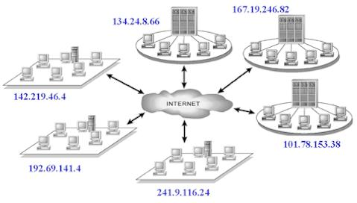
What is an IP Address?
IP= Internet Protocol
identifies each computer or device connected to the internet (it’s like your home address)
Every computer that connects to the Internet has an identifying number (IP address):
192.102.249.3
Consists of 4 numbers with dots between them
Each number ranges from 0 to 255

Slide 14
What is an IP Address?
IP addresses are NOT geographical so just think of this as an analogy not exactly done like this!
Home Address
Phone Number
IP Address
1151 Richmond Street, London, Ontario, Canada
Canada
Ontario
London
1151 Richmond Street
1 (519) 679-2117
1
519
679
2117
129.100.23.247
129
100
23
247
identifies each computer or device connected to the internet

Slide 15
What is an IP Address?
IP Address expressed in:
Type | Example
Dotted Quad | 129.100.23.247
Binary | 10000001 01100100 00010111 11110111 (32 bits= 4 bytes)
Hexadecimal | 81 64 17 F7
Decimal | 2,170,820,599
MOST POPULAR NOTATION

Slide 16
How to send the message, for example a webpage.
Watch this movie:
How data moves around on Internet
http://video.google.com/videoplay?docid=2334456354057526076&ei=8VDGSp3YFpLSqQLTlLzhDA&q=tcp+ip&hl=en#docid=5023268532827876792
SUMMARY:
TCP breaks webpage into packets of bytes
TCP figures out IP address of where it wants to send the packets (destination)
TCP figures out IP address of where the packet is coming from (source)
IP picks a route for a packet, stopping at routers (devices) which pick the next best machine/network to send the packet to
TCP sends off each packet to first machine (IP Address) on the route (DOES NOT PREPLAN ROUTE!)
Packet stops at first machine, likely a router, then the router sends it to the next machine on the journey (IP Address) and so on until it gets to the final IP Address (destination)
Called Packet Switching

Slide 17
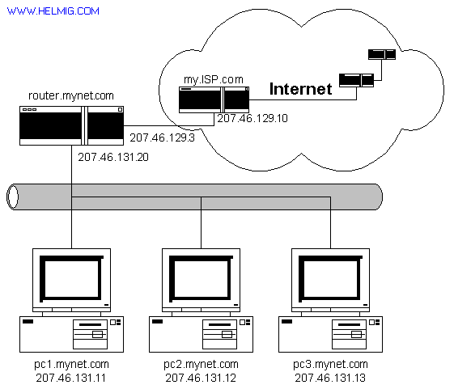

How to see the
actual route:
At the command prompt, type:
tracert 74.125.95.99
Watch this movie:
http://www.youtube.com/watch?v=tAv_eLm7DMk

Slide 18

Some Experiments with IP Addresses
If you have a laptop, type the following IP address into the address bar of your web browser: 129.100.23.247 and hit enter:
Now try these:
  198.96.181.102 → http://www4.bmo.com/
  98.158.91.201 → http://www.chapters.indigo.ca
  Use this tool http://www.hcidata.info/host2ip.htm

Slide 19
Another Experiment
Gives you IP of a website address
In Windows, go to
Start>All Programs>Accessories>Command Prompt
Other options, from your browser:
Go to: http://www.hcidata.info/host2ip.htm
Go to: http://www.whatismyip.com/
Type: ipconfig (to find your ip address)
Or
Type: ping www.google.ca

Slide 20
Recap
IP Address expressed in:
Type | Example
Dotted Quad | 129.100.23.247
Binary | 10000001 01100100 00010111 11110111 (32 bits= 4 bytes)
Hexadecimal | 81 64 17 F7
Decimal | 2,170,820,599
Problem:
Can you remember an IP address?
192.102.249.3
“Domain Name”

Slide 21
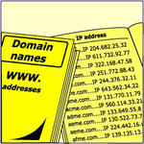
IP Addresses and Domain Names
What is a Domain Name?
Text name corresponding to the
numeric IP address of a computer on the Internet.
  uwo.ca = 129.100.0.45
  csd.uwo.ca = 129.100.10.247
  identifies the network
  specific computer

Slide 22
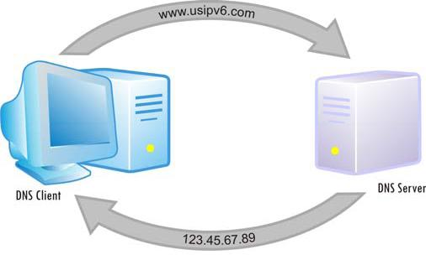
How does a Domain Name Work?
Every machine on the internet gets an IP Address
A DNS(Domain Name System) maps the domain name to the correct IP address so data can route to the correct computer
DNS SERVER
1 IP to 1 Domain
129.100.23.247
Maps to
www.csd.uwo.ca
1 IP to > Domain
155.12.12.12
www.chapters.ca
www.indigo.ca
1 Domain to > IP Address
155.12.12.1
155.12.12.2
155.12.12.77
Might all be web server machines for www.msn.com
Converter: IP ← → domain name www.hcidata.co.uk/host2ip.htm

Slide 23
Web Addresses and URLs
URL: ( Uniform Resource Locator )
  Also known as the website address
  Every webpage is referred to by a URL
  Is an address of a web document on a computer
  Tim Berners Lee established the URL designation
www.uwo.ca
www.youtube.com
www.csd.uwo.ca/courses/CS1033

Slide 24
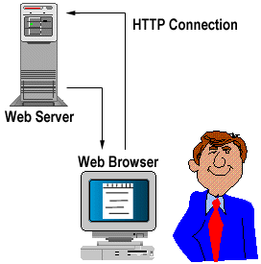
So where do things sit?
Domain Names identify machines on the Internet, for example a web server machine.
Web server contains all the web pages for a company or individual
Web pages are stored on the web server machine
(sometimes the machine is called a host (a web site is really a folder)).
Web pages are just files, usually with the extension .html, for example: myhomepage.html or prices.html
Webpages are stored in:
Folder for its – www.uwo.ca/its
Folder for fammed – www.uwo.ca/fammed
Folder for physics - www.uwo.ca/physics
Uses TCP/IP
Host machine
Type in browser:
http://www.uwo.ca/its

Slide 25
Web Addresses and URLs
Path and File
Tells browser where to find page(s)
Web server Name
http://www.uwo.ca/its/courses/spring.html
File
spring.html is a webpage file
Hypertext
Transder
Protocol
Rules that define how data is exchanged between servers and browsers
Other examples:
ftp://, news://
Folder
It is a folder on the web server machine
World Wide Web
Indicates file is on the World Wide Web
Domain Name
The name of the site. Points to web server
Folder
courses is a folder inside the its folder

Slide 26
Subdomains
Used to organize your web server (just like folders and directories organize your computer)
Compare:
Subdomains are commonly used by orginzatiions that wish to assign a unique name to a particlar department, fucntion, or service related to the orgianization
http://www.brescia.uwo.cahttp://www.law.uwo.ca
http://www.eng.uwo.ca
http://www.ivey.uwo.ca/
http://www.alumni.uwo.ca/
http://www.csd.uwo.ca
_x000b_http://www.uwo.ca
http://www.youtube.com
http://tdcanadatrust.com

Slide 27
Subdomains
http://www.year2005.mycorvettes.mycars.com
year2005.mycorvettes.mycars.com
Rules:
Max of 127 labels
Each label (level) max 63 chars long
But whole domain cannot exceed 255 chars (incl. TLD)
4th level
3rd level
2nd level
(min of 3 chars)
TLD
(top level domain)
What does this mean?
Domain: mycars.com
Subdomain: mycorvettes
Subdomain: year2005
mycorvettes is a subdomain of mycars.com
year2005 is a subdomain of mycorvetters.mycars.com

Slide 28
Subdomains
http://www.abc.def.hij.com
Questions:
How many levels does the above
domain name have?
How many sub domains does the above domain name have?
4
2 subdomains
      def is a subdomain of hij.com
      abc is a subdomain of def.hij.com

Slide 29

Domain Name History
In 1973: IP Address became the standardized way to identify machines on the Internet.
In 1984: University of Wisconsin came up with a name server, that maps a name to an IP address.
In 1985: Domain Name System is established and the initial top level domain names are introduced.
Notes:
.com, .net, .org

Slide 30
Domain Name History
In 1990: Internet moves beyond of the world of the government and universities and into the commercial society.
Up until 1995: you didn’t have to pay for your domain name, 1995 to 1998 you paid the NSF (National Science Foundation) $100 US dollars for a 2 year registration for a domain name.
In 1998: the assignment of domain name is opened up to private companies to encourage competition.

Slide 31



Where do I start?
Advertising/
Marketing
Starting a Business
Business Card
Brochure

Slide 32
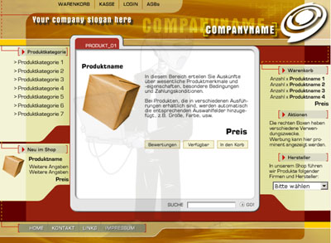
Starting a Business
Competition is fierce!
A Website is essential
Nowadays your customers don’t just want a website from you,
THEY EXPECT A WEBSITE!
___________________
___________________
__________________

Slide 33


Slide 34

MULTIMEDIA
Exploring multimedia components
Text
Images
Animation
Sound
Video
COMMUNICATIONS
Effectively
Clear
Exact
Professional
Make an
impression!
More info!
Customer Sophistication
______________________
______________________
______________________

Slide 35
Successful businesses take full advantage of the Internet:
Google → Fact: as of 2007, Google passes Microsoft as the most visited website in the world.
  Question: Name some other sites that have now passed Microsoft → http://toolbar.netcraft.com/stats/topsites
EBAY → Let’s take a look:
Notes:
Facebook, myspace, youtube

Slide 36
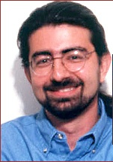
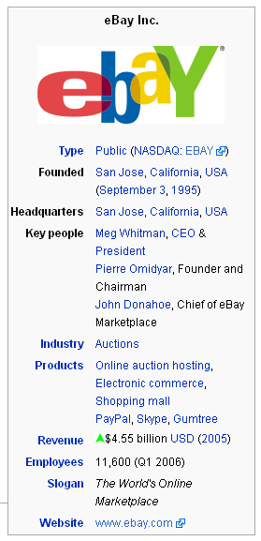

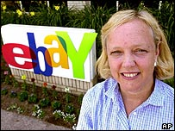
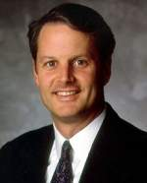
Pierre Omidyar
Echo Bay Consulting
Sept 1995
“broken” Laser pointer
Jeff Skol- Standford MBA
Sept 1996
Sept 1998
Went public
Meg Whitman
– Harvard - Hasbro
John Donahue
Chief of Ebay

Slide 37
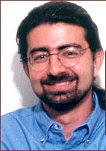
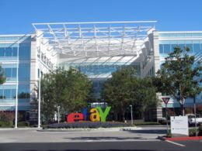
Pierre Omidyar
Echo Bay Consulting
Sept 1995
“broken” Laser pointer
Jeff Skol- Standford MBA
Sept 1996
Sept 1998
Went public
Meg Whitman
– Harvard - Hasbro
What is Ebay known for?
Online auction and shopping website
John Donahue
Chief of Ebay

Slide 38
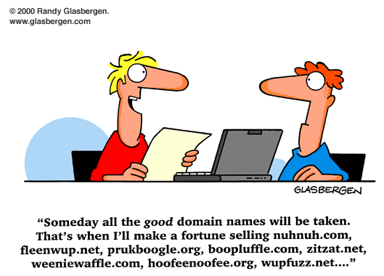
Setting up a Website
Choose a Domain Name
http://www.youtube.com/watch?v=7WpmdaUGWL0
Order Web Hosting
Meet with Client
Begin building the website

Slide 39
Setting up a Website:
Choosing a Domain Name
What name do I use?
www.homewatchers.com
http://www.uwo.ca/its/courses/spring.html
Domain name is:
_________________
Domain name is:
_______________
Same?
ABC.com
abc.com
  Answer: _____
  _____________
Domain Name rules:
  Max of 67 chars (incl. extension)
  0-9 a-z
  Dash char (hyphen) “-”
  No spaces
  Cannot start/end with dash

Slide 40
Setting up a Website:
Rules for Domain Names
Must use one of the approved TLDs
Each level must consist of:
letters, digits and hyphens.
CANNOT start with a hyphen or end with a hyphen.
CANNOT contain a space.
Domain names are case insensitive.
Question: Do these domain names represent the same domain?
→ dogsrus.com
→ DogsRUs.com
Domain Name | Valid or Invalid
we are the world.org
We-Are-The-World.org
We_Are_The_World.org
WeAre99%OfTheWorld.org
We.Are.The.World.org
-weare.theworld-.org

Slide 41
Setting up a Website:
TLD – Top Level Domains
What TLD do I pick for my domain name?
homewatchers.com homewatchers.org
TLD (Top Level Domains)
.com | Commercial organization, business, companies
.net | Internet administrative site, network providers
.org | Non-Profit Organizations
.edu | Educational instituitions
.gov | Government agencies
.info | Information
.biz | Business
TLD Idenitifies the _______________
that is associated with the domain

Slide 42
Setting up a Website:
TLD – Top Level Domains
.ca | Canada
.us | United States
.gs | South Georgia & the South Sandwich Islands
.tc | Turks and Caicos Islands
.tv | Tuvalu, but often used for television
.uk | United Kingdom
.de | Germany
.eu | European Union
.be | Belgium
.cn | China
.tw | Taiwan
.at | Austria
.nz | New Zealand
.mx | Mexico
http://www.santorini-villas.gr
http://europa.eu/
http://www.atuk.co.uk/

Slide 43

How do you pick a
Domain Name?

Slide 44

Setting up a Website:
Choosing a Domain Name
Cost:
You pay for securing the DOMAIN NAME on a per year basis
(registration company, domain extension)
Must re-new domain name for another year
Is domain name available?
www.homewatchers.com
Check for availability
www.mydomain.com
www.yahoo.com (limitations)
www.register.com
www.godaddy.com (show this)
1and1
Different sites show you different options

Slide 45
Setting up a Website:
Choosing a Domain Name - Suggestions
1. Keywords, Keywords, Keywords-
pick a domain name with our keywords in it.
Search engines give a lot of weight to domain names.
2. Be Memorable-
Descriptive, memorable, and easy to spell
3. Avoid Hyphens-
Use if you really don’t have a choice!
www.joshfuller.com ←→ www.josh-fuller.com.
4. Buy .Com First
It is default extension in most people’s mind.
Then try .org, .net, .biz etc. (register these as well)

Slide 46
Setting up a Website:
Choosing a Domain Name - Suggestions
5. Keep it Short-
People remember short website names
Ie. www.pcworld.com vs. www.powercomputingworld.com
6. Kill Procrastination- Register asap
7. Get Creative
If your first choice is already taken. Add “e” or “i” or a number in front of a name
    www.isurfing.com
Another secret: Add “web” or “net” in front or at the end of a name. Combine short, meaningful, catchy phrases or words that describe your business or site.
www.cheaptrips.com is taken
Then try www.webcheaptrips.com or www.cheaptrips4u.com

Slide 47
Setting up a Website:
Choosing a Domain Name - Suggestions
8. Know the Rules of domain names -
9. Testing, Testing, 123-
Try it out on others before buying.
10. Buy up “Mispelled domains”
www.cheaptrips.com, www.cheaptrips.com, www.cheaptrip.com
www.utube.com, instead of www.youtube (try this and see what happens)
Try going to www.bras.com and www.underwear.com WHERE DO YOU END UP?

Slide 48
Setting up a Website:
Choosing a Domain Name - Suggestions
11. Which Online Realtor to Use?
Go to www.GoDaddy.com.
See if domain name is available.
Register it Once you find a name that works,
Your new domain name will only cost you $8 - $10.
don’t buy extra services
Must register ever year to keep rights to it!
Other on-line places to purchase:
  www.godaddy.com
  www.mydomain.com
  www.yahoo.com
  www.register.com
Pay per year, must re-register every year or every few years

Slide 49
Setting up a Website:
Order Web Hosting
Find a company that will hold/host your website (keep the files that make up your website)
OR
Perhaps you can set up your own webserver in at your company or home?
Choose a Domain Name
Order Web Hosting
Meet with Client
Begin building the website

Slide 50
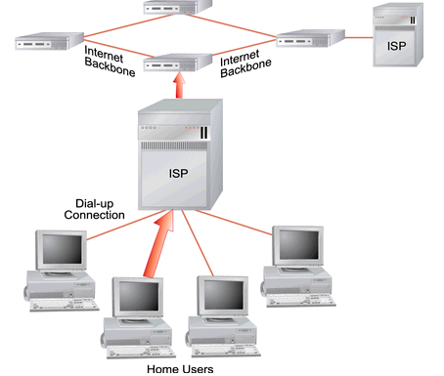
Setting up a Website:
Order Web Hosting
To make your website available to the internet community, the website files need to be hosted on a web server provided by an ISP
Web Hosting:
The _______that provides Internet users with online systems for storing information, images, video, or any content accessible via the web.
Web Hosts:
ISP: Internet Service Providers
_________ that provide space on a server they own for use by their clients as well as providing Internet connectivity
ex. Rogers, Execulink, AOL, etc.
Rogers, Bell
ISP provides:
  User accounts for accessing internet
  Email access
  Web Space to host/hold your website

Slide 51
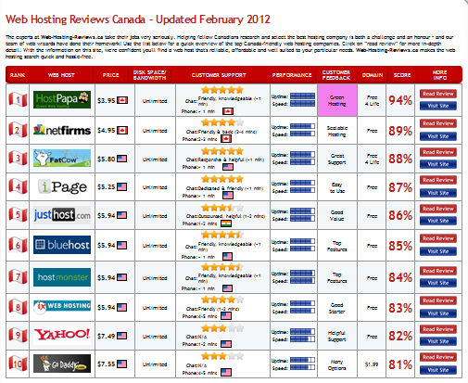
http://www.web-hosting-reviews.ca/

Slide 52

Setting up a Website:
Order Web Hosting
Compare Pricing
Shop Around - reputable SHOP AROUND
Compare Pricing – features offered, e-mail accounts etc.
Barter to bring price down – leverage if two websites
One year commitment vs month–by-month
Handling fees for domain name, transferring
Search Engine Promotion services
Ask what other services they provide

Slide 53

Setting up a Website:
Order Web Hosting
Top 8 Reasons when picking an ISP
Web Provider → Reliability? How long? Popular?
Technical Support → Test by sending them an e-mail and see response time, Contact names, e-mails, phone numbers, hotlines
Disk Space → Always get more, Standard 5 GB – 10 GB
UpTime → Look for 99% plus guaranteed
Database/Programming Language Support → Needs for dynamic website – interact with customers. Perl, Java, PHP etc…

Slide 54
Setting up a Website:
Order Web Hosting
Top 8 Reasons when picking an ISP
FTP Access → Unlimited and unrestricted FTP access for easy maintenance
Web Statistics Summary: → Traffic on your website- Easy access to your information… control
Scripts availability → counters, forms support.

Slide 55
Setting up a Website:
Order Web Hosting
4 Reasons NOT to Host Your Own Website:
Expensive: Server and server software (web server, mail server, firewall, virus protection etc.) can be expensive.
Continual Connection: The server needs a 24/7 high speed connection to the internet, which is relatively costly.
Technical: Setting up all the configurations including mail server, FTP server and DNS server can be complicated.
Support: Server maintenance requires 24 hour support, special skills and knowledge.

Slide 56
Warm up Questions:
What are the chunks of data that are sent over the internet called?
True or false, the Internet and the World Wide Web are the same thing?
Give an example of a valid IP address.
True or false, www.csd.uwo.ca/courses is a domain name?

Slide 57
Give 3 valid TLDs
The domain name for the url www.homer.simpson.com is homer.simpson.com. TRUE or FALSE
Zack&Cody.Love.You.2.com is a valid domain name. TRUE or FALSE
What is a message (a webpage or an email message or a file) on the Internet broken down into before it is sent over the net?
Are the following valid IP addresses?
  1.1.1.1
  126.265.13.10
  129.129.129

Slide 58
Question: Match the words on the left to the way they are represented on the right:
Machine/Host (usually called www)
File
Folder/directory
Web Page
Web Site
Web Server

Slide 59
Okay!
Got my Domain Name
Internet Service Provider

